Slide 1

Analyzing and Classifying Discount Behavior with Machine Learning Models
Group 8: Boss Paspanthong, Hao Liang, Licheng Du, Ziyi Zhou

Slide 2
Project Outline
EDA
SQL Query
Feature Engineering
Time: Month
Modelling
Logistic
ROI
Data Cleaning
Data Visualization
Brands: Clustering
Discount: binary
Random Forest
Business Assumption
Cost/Gain Analysis
ROI Result

Slide 3
EDA

Slide 4
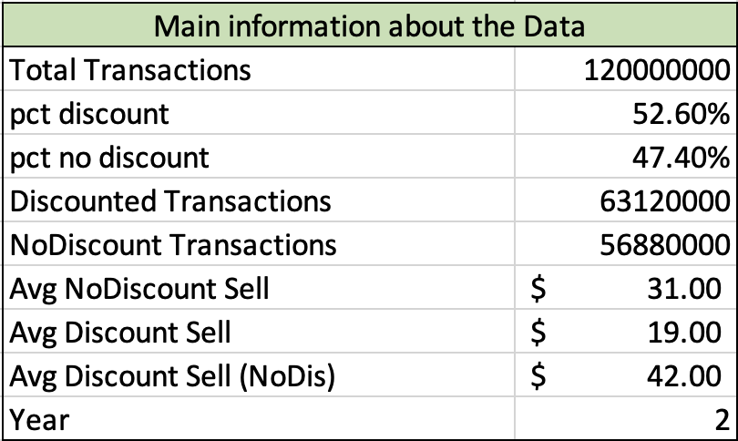



Data Description
Point-of-Sales (POS)
Stock-Keeping-Unit (SKU)
2,600 Distinct Brands
Transactions
2 years
120 million reocrds
Store Info
29 Distinct States
327 Distinct Zip Codes
Others

Slide 5
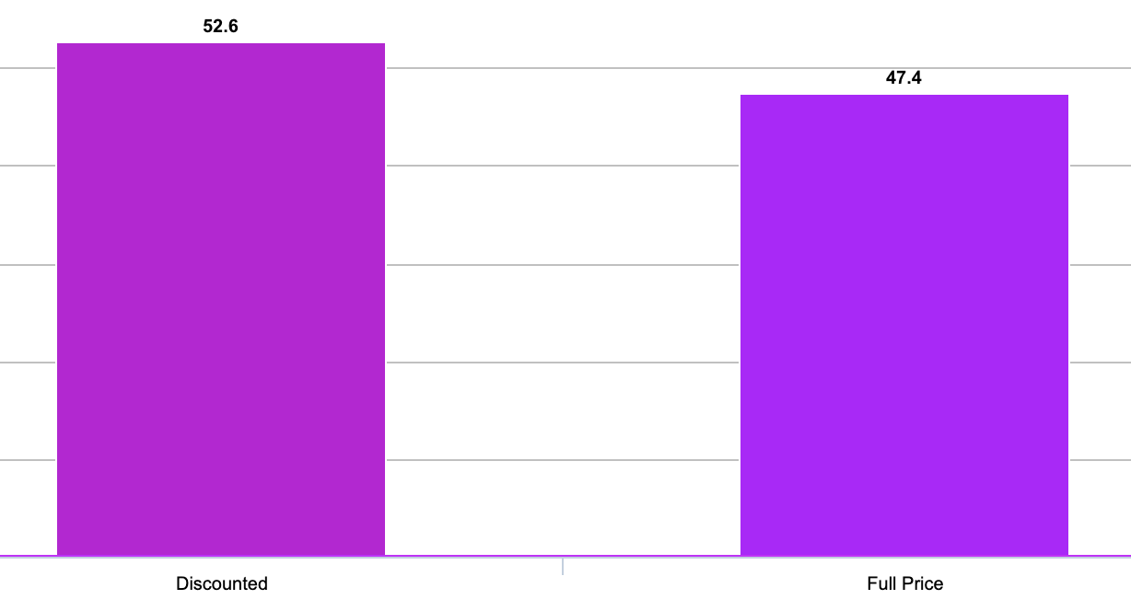
Discount Percentage
120 million transactions in 2004 & 2005
No data imbalanced issue to be considered

Slide 6
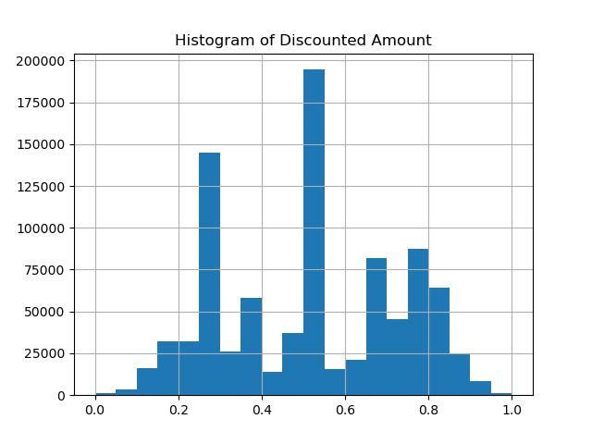
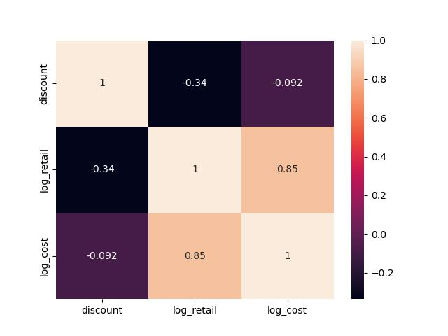
Majority of transactions that were
discounted are 50% off or 25% off
Relationship between log(retail price)
and log(retail cost) is negative
*2 million transaction data was chosen for data visualization because of computing efficiency.

Slide 7
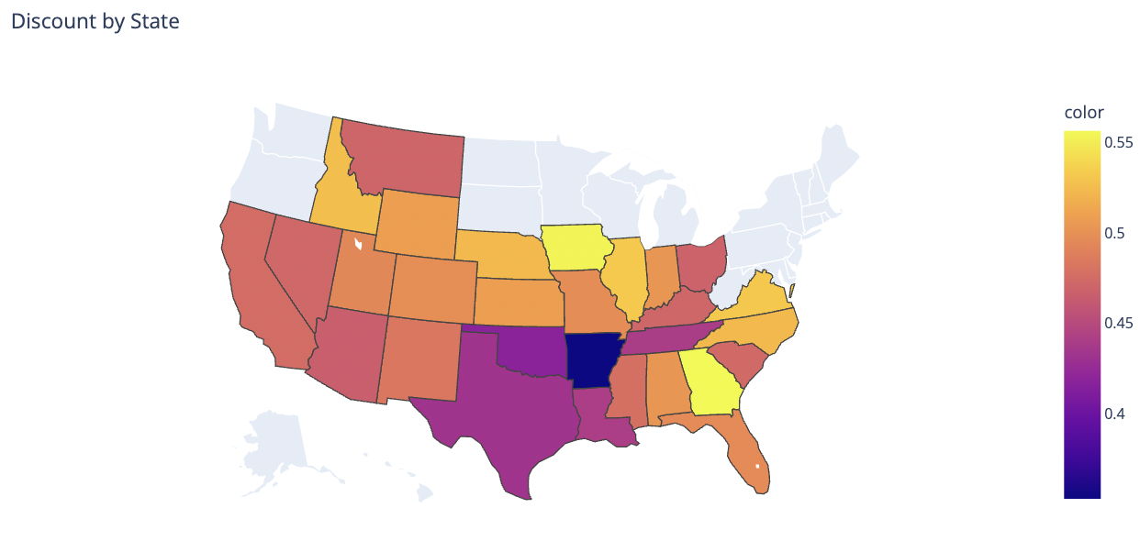
Middle & South states tend to have the less discount selling
Iowa and Georgia have the highest discount proportion
Due to the small variation, states could be a great secondary feature
*2 million transaction data was chosen for data visualization because of computing efficiency.

Slide 8
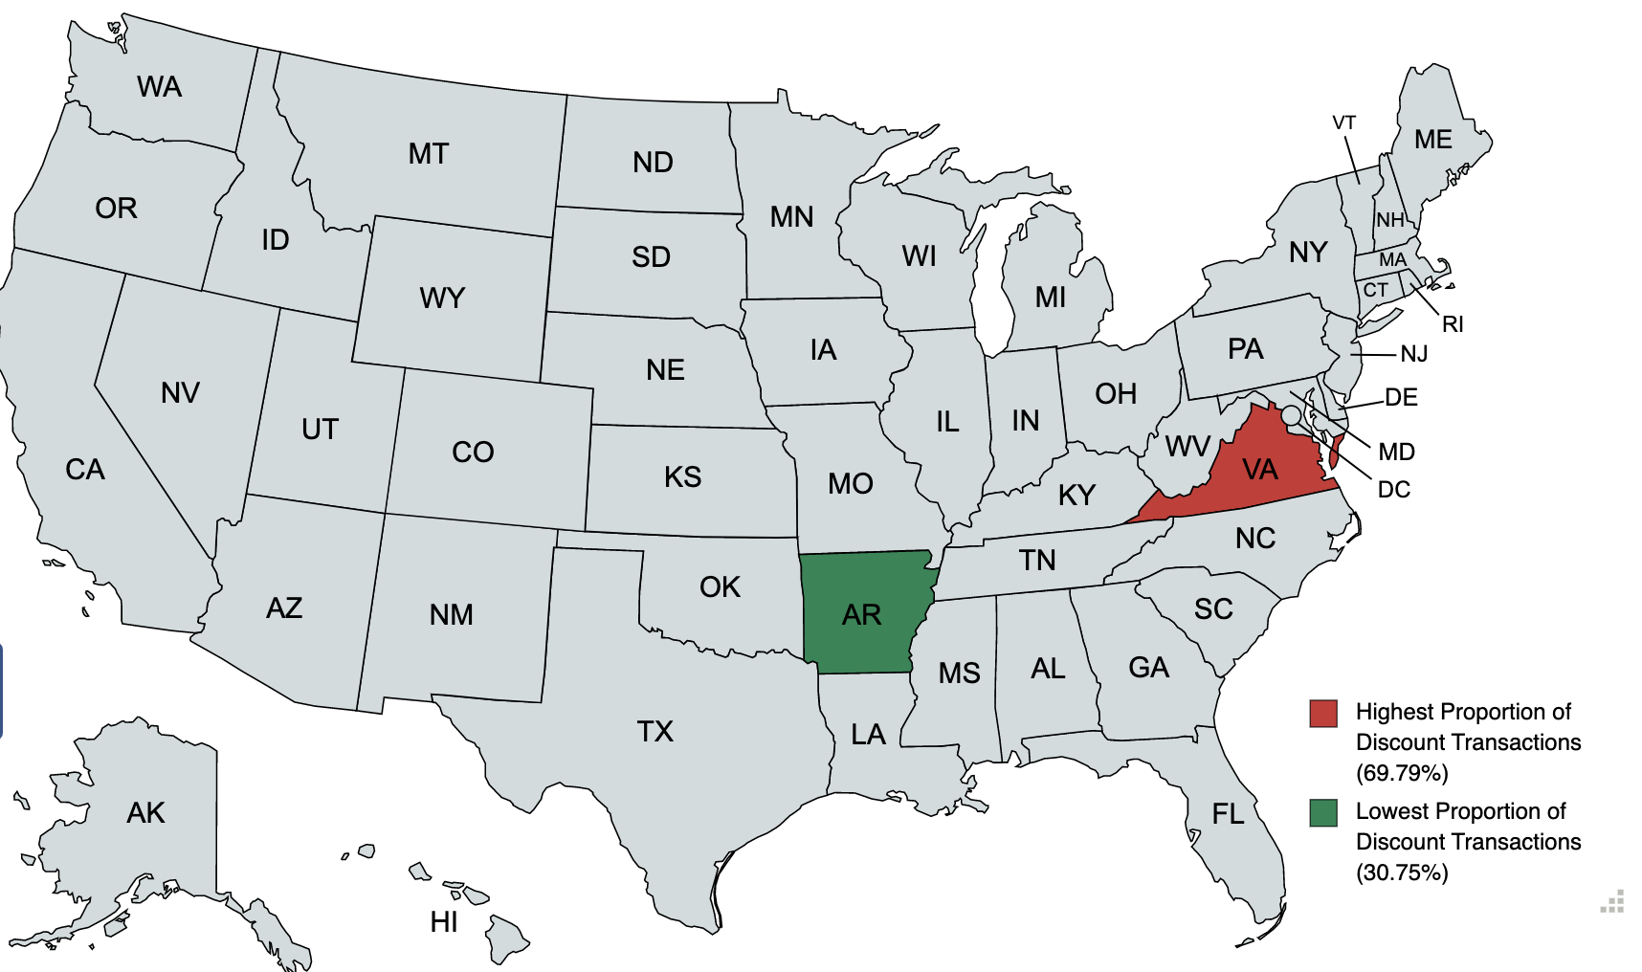
Data Visualization*
States with Highest/Lowest proportion of Discount-Transaction Counties
*2 million transaction data was chosen for data visualization because of computing efficiency.

Slide 9
Feature Engineering

Slide 10
Data Preparation
Month, Zipcode, State
Clustering
One-Hot Encoding
Discount
Yes (1) & No (0)
Brands

Slide 11
Brands Clustering
Brands
One Cluster: New brand to the market (only have one product in the market)
Four Clusters: Equally separate brands into four groups based on average retail prices of their products

Slide 12
Modelling

Slide 13
Logistic Regression
Standard Logistic Regression
Ridge Regression
Lasso Regression
Cross-Validation (Lambda = 0.01,0.1,1,2,5,10)

Slide 14
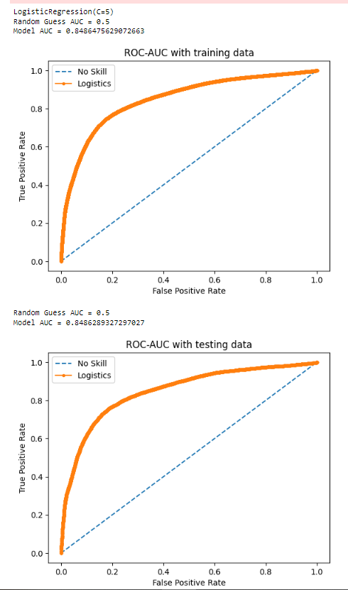
Best Logistic Regression
Ridge Penalty & Lambda of 0.1
AUC: 0.85

Slide 15
Random Forest
Cross-Validation
Max Depth of the Tree
4, 5
No. features:
square root of number of features
log of number of features
No. trees:
15, 50, 100

Slide 16
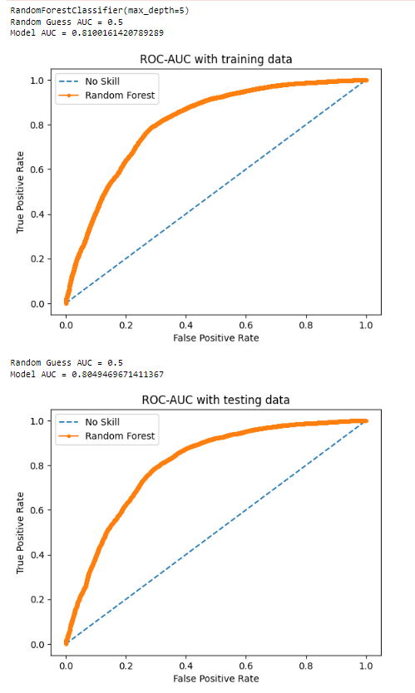
Best Random Forest
Features:
Max Depth of the Tree: 5
No. features: log of number of features
No. trees: 50
AUC: 0.81

Slide 17

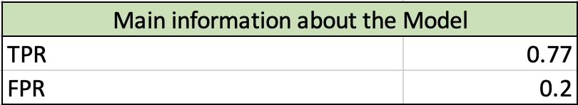
Model Comparison
Logistic Regression
Best Model AUC: 0.85
Random Forest
Best Model AUC: 0.81

Slide 18
ROI

Slide 19
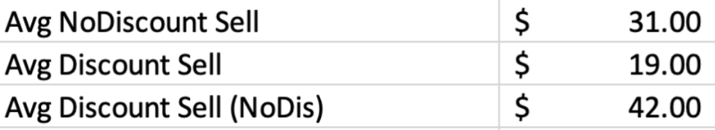
Model Selection
Logistic Regression with AUC of 0.85
Sales’ Data

Slide 20
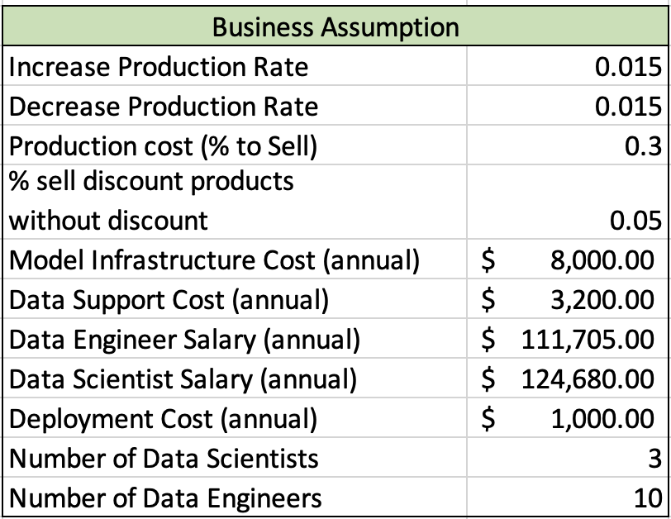
Business Assumption

Slide 21
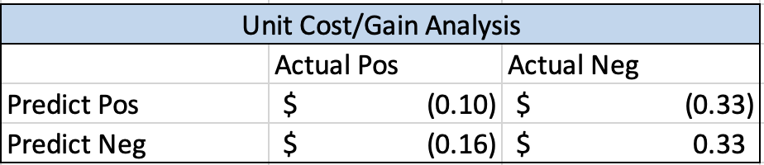
Unit Cost/Gain Analysis
Classes: Positive (discount), Negative (non-discount)
True Negative:
Gain $0.33 per transaction
1.5% * ($31 – 30%*$31)
True Positive:
Loss $0.1 per transaction
-1.5% * ($19 – 30%*$42)
False Positive:
Loss $0.33 per transaction
-1.5% * ($31 – 30%*$31)
False Negative:
Loss $0.16 per transaction
1.5% * (5%*$42 – 30%*$42)
Gain from increase in production
Loss from decrease in production
Loss from decrease in production
Loss from not able to sell products as expected (products need discount to be sold)

Slide 22
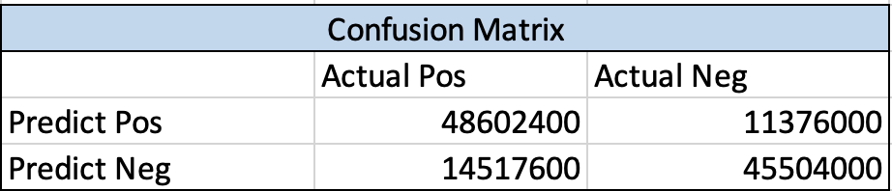
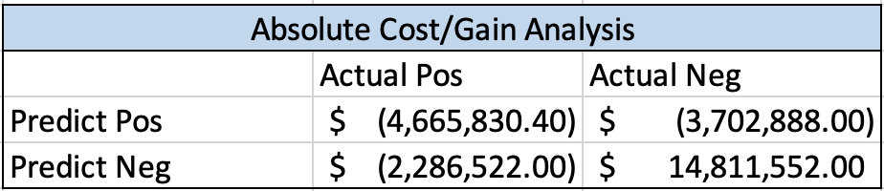
Confusion Matrix

Slide 23
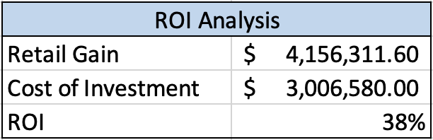
ROI Result

Slide 24
THANK YOU

